Slide 1


Designed Big Data: Blending Surveys and Digital Trace Data
Bella Struminskaya

Slide 2
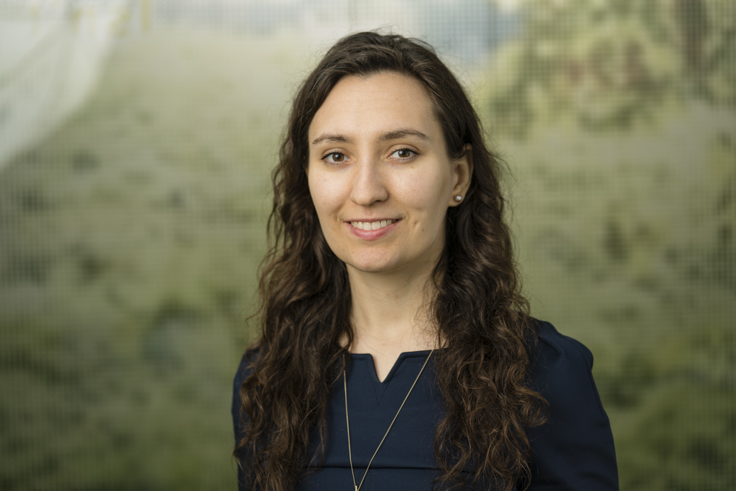




Short introduction
Assistant Professor Utrecht University
Affiliated Researcher Statistics Netherlands
Data Collection Committee ODISSEI Observatory (GGP, ESS, SHARE, EVS, NKO)
Board member German Society for Online Research (DGOF)
Board member IEDI – Integrated Data Collection Infrastructure
AAPOR Education Committee member
Senior researcher / junior researcher at GESIS (2010-2016)
PhD Methodology & Statistics, Utrecht University (2014)
M.A. Sociology University of Mannheim (2010)

Slide 3
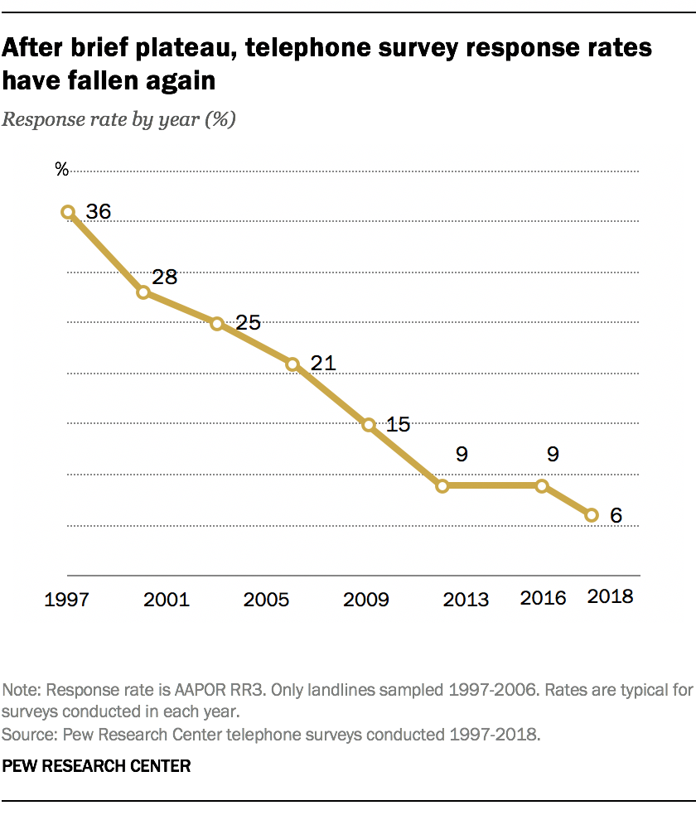







Problem
Opportunity
Solution (?)
Source: Pew Research Center 2019

Slide 4
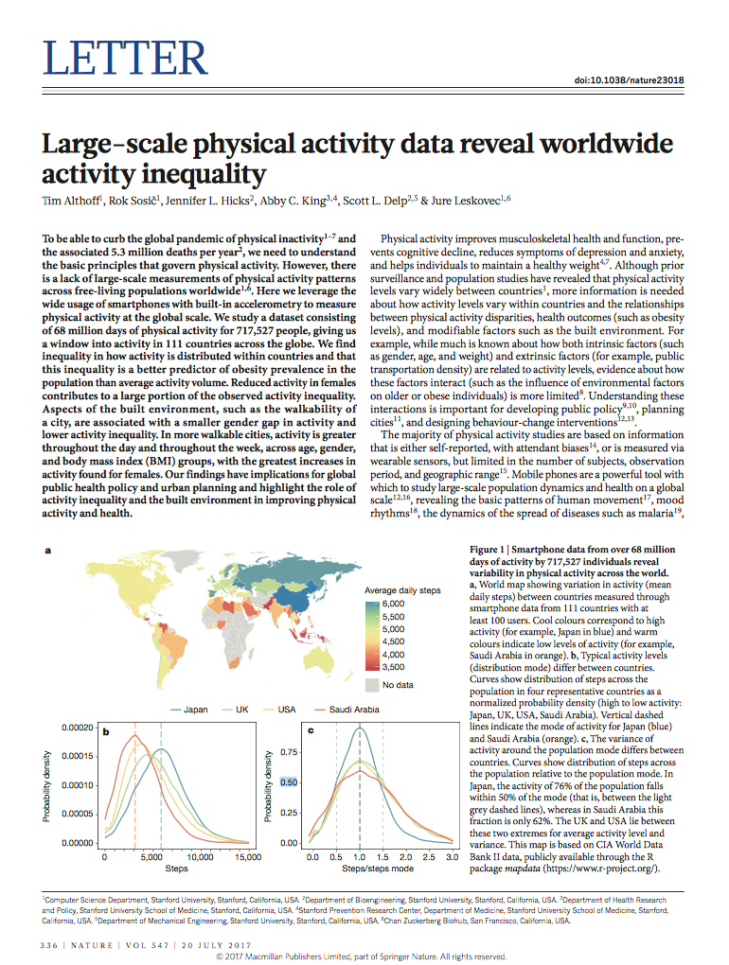
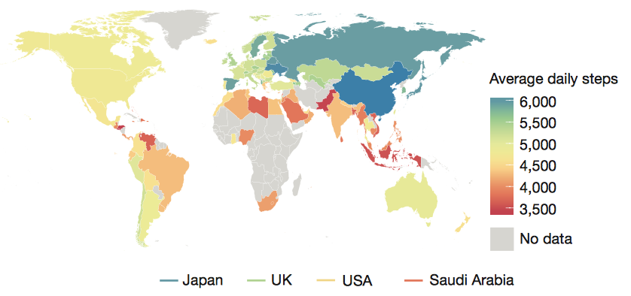
Can we study physical activity using passive data?
Althoff, T., Hicks, J. L., King, A. C., Delp, S. L., & Leskovec, J. (2017). Large-scale physical activity data reveal worldwide activity inequality. Nature, 547 (7663), 336-339

Slide 5
Total (Survey) Error & Althoff et al.
Construct
Target Population
device carrying patterns
(In)validity
Coverage Error
only iPhone users
Measurement
Sampling Frame
Sampling Error
only volunteers
device malfunction/
out of power
Measurement Error
Sample
Response
Nonresponse Error
only those who downloaded the app
recognizing activity types
Processing Error
Respondents
Edited Response
Adjustment Error
population characteristics known?
Postsurvey Adjustments
Survey Statistic
(Groves et al. 2004)

Slide 6
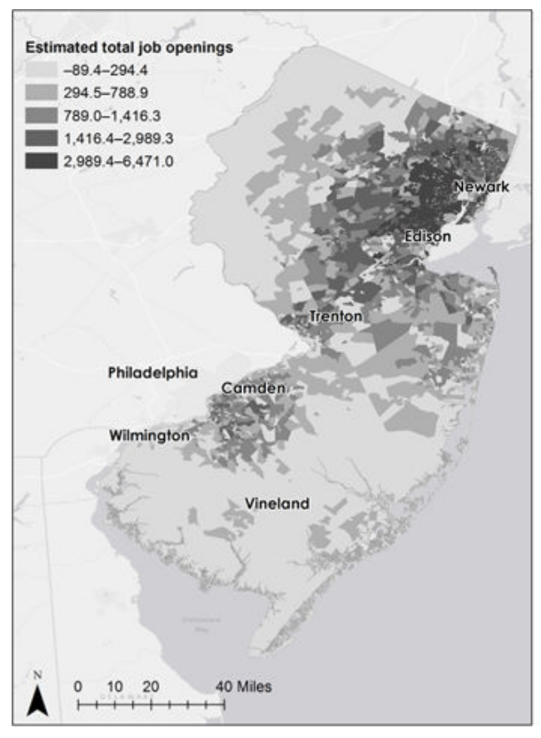
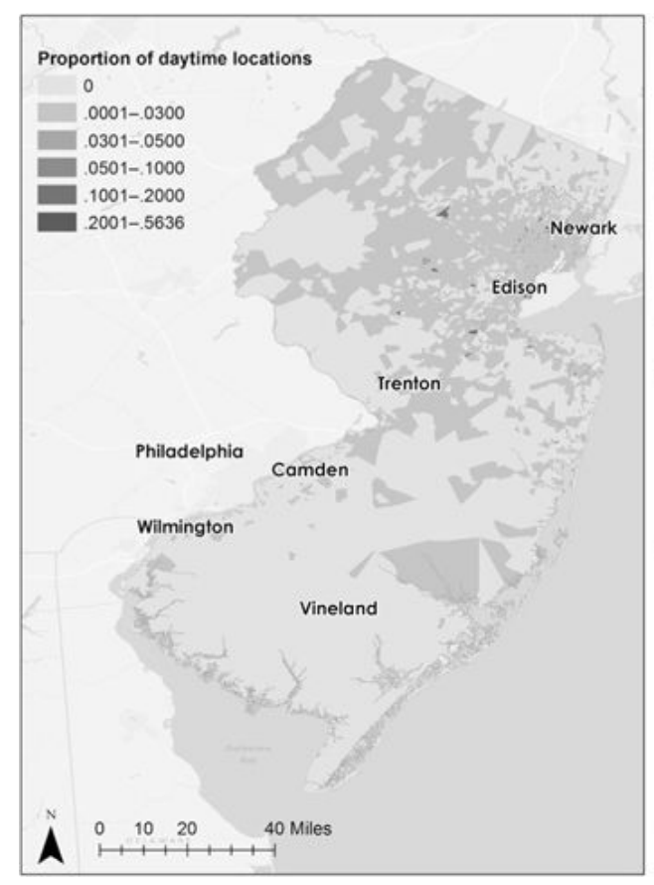
Can we study job search and work behavior of marginalized job seekers?
133 parolees (RR 89%)
Geolocation, calls & texts, EMA
Spatial mismatch: low-skilled, nonwhite job seekers within central cities, job opportunities in outlying areas
Residential mismatch lengthens time to employment
Mobility can compensate for residential deficits
Daytime locations of parolees
Job openings
(Sugie 2018; Sugie and Lens 2017)
Notes:
employment accessibility measures are derived from data from the Longitudinal Employer-Household Dynamics (LEHD) files, produced by the U.S. Census Bureau

Slide 7
Bridging the gap between surveys and Big Data

Slide 8
“Designed Big Data”
or a
Sampling frame
(Struminskaya et al. 2020)

Slide 9
What are the mechanisms of WTS and sharing of app, sensor, and digital trace data?

Slide 10
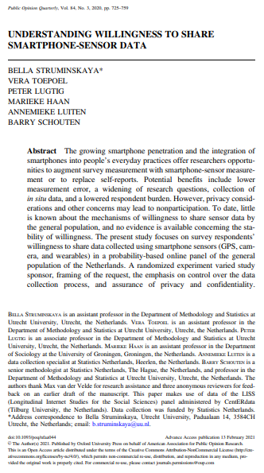
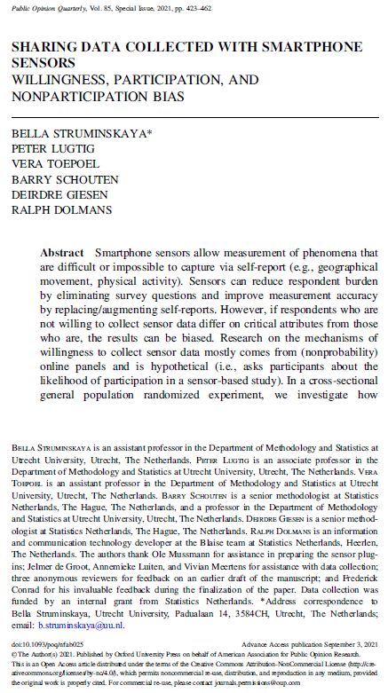
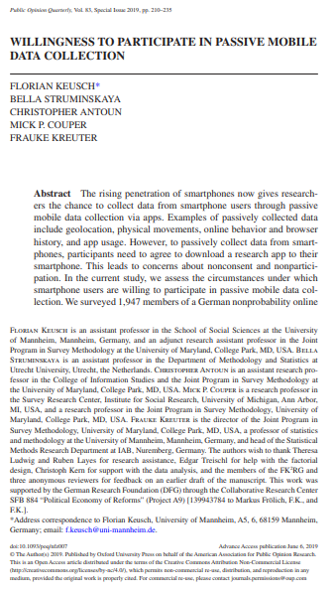

Slide 11
Struminskaya et al. 2021
Struminskaya et al. 2020
Keusch et al. 2019
WTS & actual sharing
Cross-section* (NL) COOP2=54%
GPS, photos, video; no app
Requests with rand. assig.: Autonomy over data collection Benefit framing Confidentiality assurance
Fixed order of measurements
Privacy concern, tech skills, prev. exp., survey exp.
Willingness to share (WTS)
Prob. LISS Panel (NL) 2 waves, RR1 = 89%, 84%
Share GPS, photos, video
Vignettes w rand. assig.: Sponsor Autonomy over data collection Benefit framing Confidentiality assurance
Randomized order of tasks
Privacy concern, tech skills, prev. exp., survey exp.
Willingness to share (WTS)
Nonprob. panel (DE) 2 waves
Download tracking app
Vignettes w rand. assig.: Sponsor Autonomy over data collection Duration Topic Incentive Questions in-app
Randomized order of vignettes
Privacy concern, tech skills, prev. exp., survey exp.

Slide 12
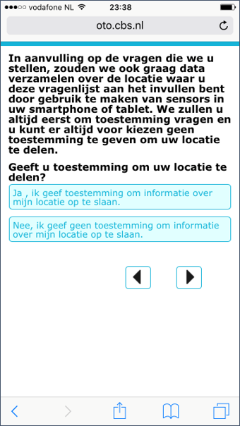
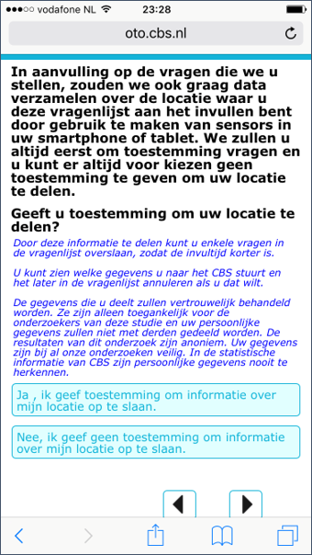
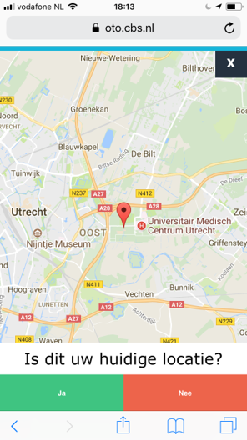
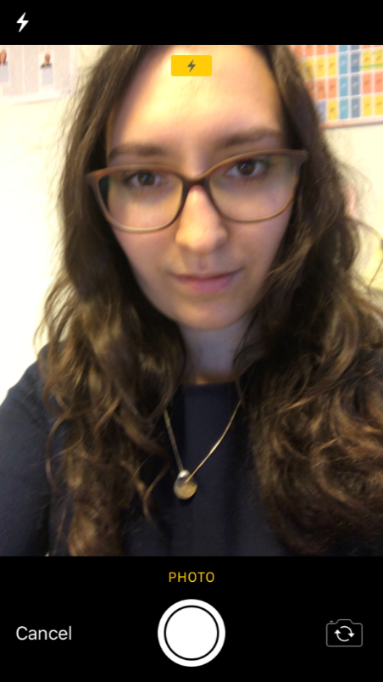
Implementation (Struminskaya et al. 2021)
Benefit
Autonomy
Privacy
General consent
Framing, autonomy, & privacy explanation
GPS measurement
Photos & Video
Notes:
Can be implemented in browser and in app. Here an example of browser consent

Slide 13
Struminskaya et al. 2021
Struminskaya et al. 2020
Keusch et al. 2019
WTS & actual sharing
Cross-section* (NL)
GPS, photos, video; no app
Requests with rand. assig.: Autonomy over data collection Benefit framing Confidentiality assurance
Fixed order of measurements
Privacy concern, tech skills, prev. exp., survey exp.
Willingness to share (WTS)
Prob. LISS Panel (NL) 2 waves
Share GPS, photos, video
Vignettes w rand. assig.: Sponsor Autonomy over data collection Benefit framing Confidentiality assurance
Randomized order of tasks
Privacy concern, tech skills, prev. exp., survey exp.
Willingness to share (WTS)
Nonprob. panel (DE) 2 waves
Download tracking app
Vignettes w rand. assig.: Sponsor Autonomy over data collection Duration Topic Incentive Questions in-app
Randomized order of vignettes
Privacy concern, tech skills, prev. exp., survey exp.

Slide 14
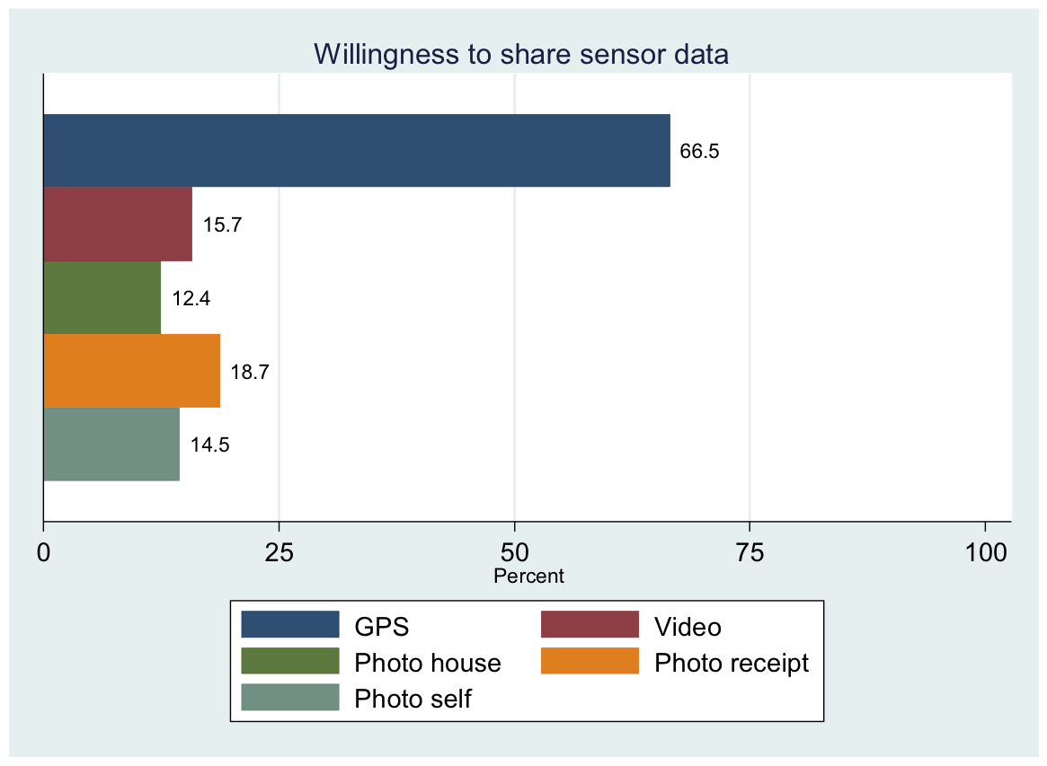
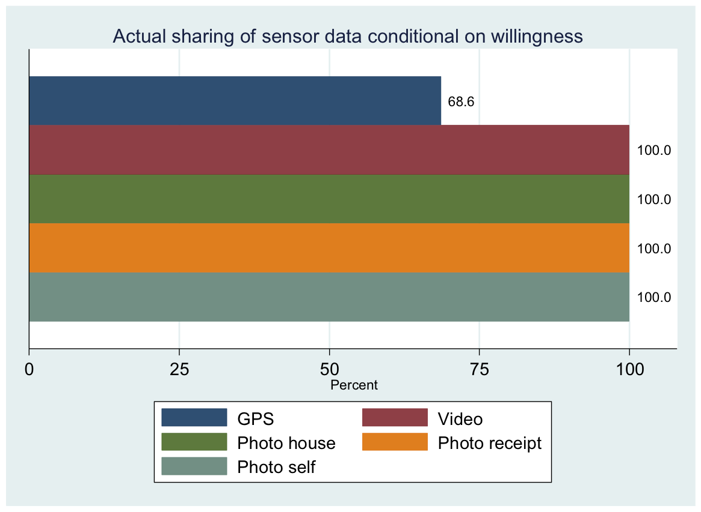
Willingness and actual sharing (Dutch cross-section)
Participation rate GPS: 45.6%; n=1883 Dutch smartphone and tablet users
(Struminskaya et al. 2021)

Slide 15
Hypothetical willingness & Order effects
Overall, randomized order
Order: GPS, Video, Photo house, Photo self
% Willing to share GPS:
If asked first: 41%
If asked last: 26%
Order effect: Average marginal effect +5.6 p.p
(Struminskaya et al. 2020)
Notes:
If GPS is asked first, 41% if it is asked last 26%

Slide 16
Willingness mechanisms
Predictors | WTS GPS | Share GPS | Share video | Share photo house | Share photo receipt | Share photo self
Benefit framing | n.s. | n.s. | n.s. | n.s. | n.s. | n.s.
Autonomy over data collection | .11*** | -.06* | n.s. | n.s. | .04* | n.s.
Privacy | n.s. | n.s. | n.s. | n.s. | n.s. | n.s.
n=1,853; Average marginal effects; covariates not shown
(Struminskaya et al. 2021)

Slide 17
Willingness mechanisms
Predictors | WTS GPS | Share GPS | Share video | Share photo house | Share photo receipt | Share photo self
Benefit framing | n.s. | n.s. | n.s. | n.s. | n.s. | n.s.
Autonomy over data collection | .11*** | -.06* | n.s. | n.s. | .04* | n.s.
Privacy | n.s. | n.s. | n.s. | n.s. | n.s. | n.s.
Predictors | Sharing
Order (asked first) | 0.02 **
Sponsor University | 0.09***
Sponsor Market Research | n.s.
Benefit framing | –0.02*
Autonomy over data collect. | n.s.
Privacy | n.s.
n=1,853; Average marginal effects; covariates not shown
n=2,669; Average marginal effects; covariates not shown
In all 3 studies: sig. effects of smartphone use behaviors, mixed findings about the effect of privacy concerns, attitudes toward surveys, prior app download
(Struminskaya et al. 2020; 2021)

Slide 18
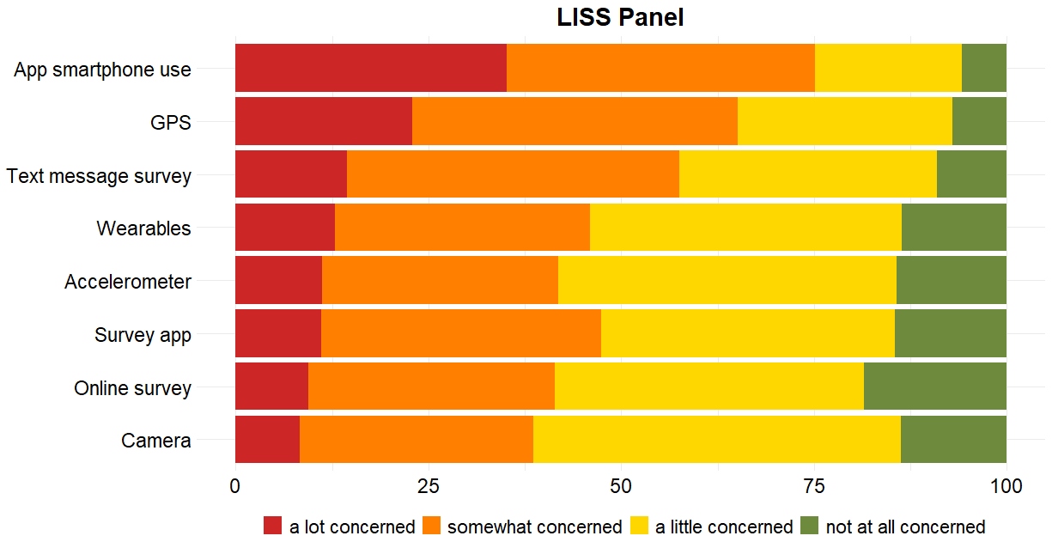
Concern by Type of Collected Data
(Struminskaya & Keusch / ODISSEI study; see also Keusch, Struminskaya et al. 2020)

Slide 19

Summary (so far)
Decisions about sharing are situation-specific, nuanced
Hypothetical behavior differs from actual participation behavior
The nature of the task more relevant than sensor
Clear communication of who asks to share & for what purpose
Balance between maximizing sharing and providing detailed information about the data (“backfire effects”)
Ceiling effects possible due to loyalty, trust in sponsor
“Is this your current location? Yes/No”

Slide 20
How much does nonparticipation matter?

Slide 21
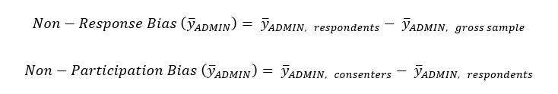
Nonresponse vs. nonparticipation bias
Survey & sensor data linked to Dutch registries: general population register, education register, households register, register of motorized vehicles, dwelling register, employment register, tax register

Slide 22
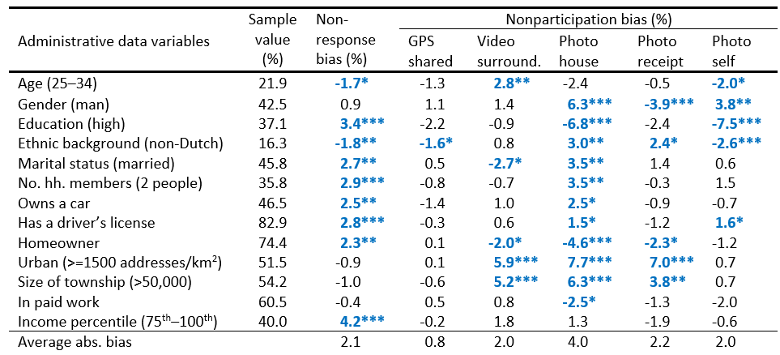

Slide 23
(Struminskaya et al. 2021)

Slide 24
Small biases, but depends on research question
Type of community
Living conditions
Financial situation
Mobility
(Struminskaya et al. 2021)

Slide 25
Does this hold for digital traces?

Slide 26
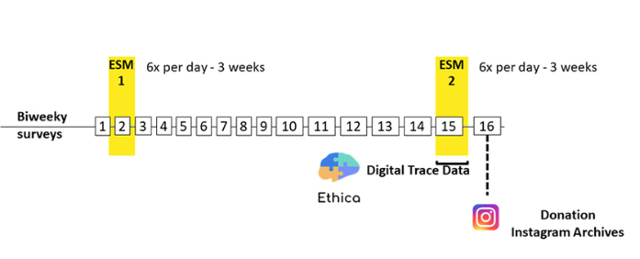
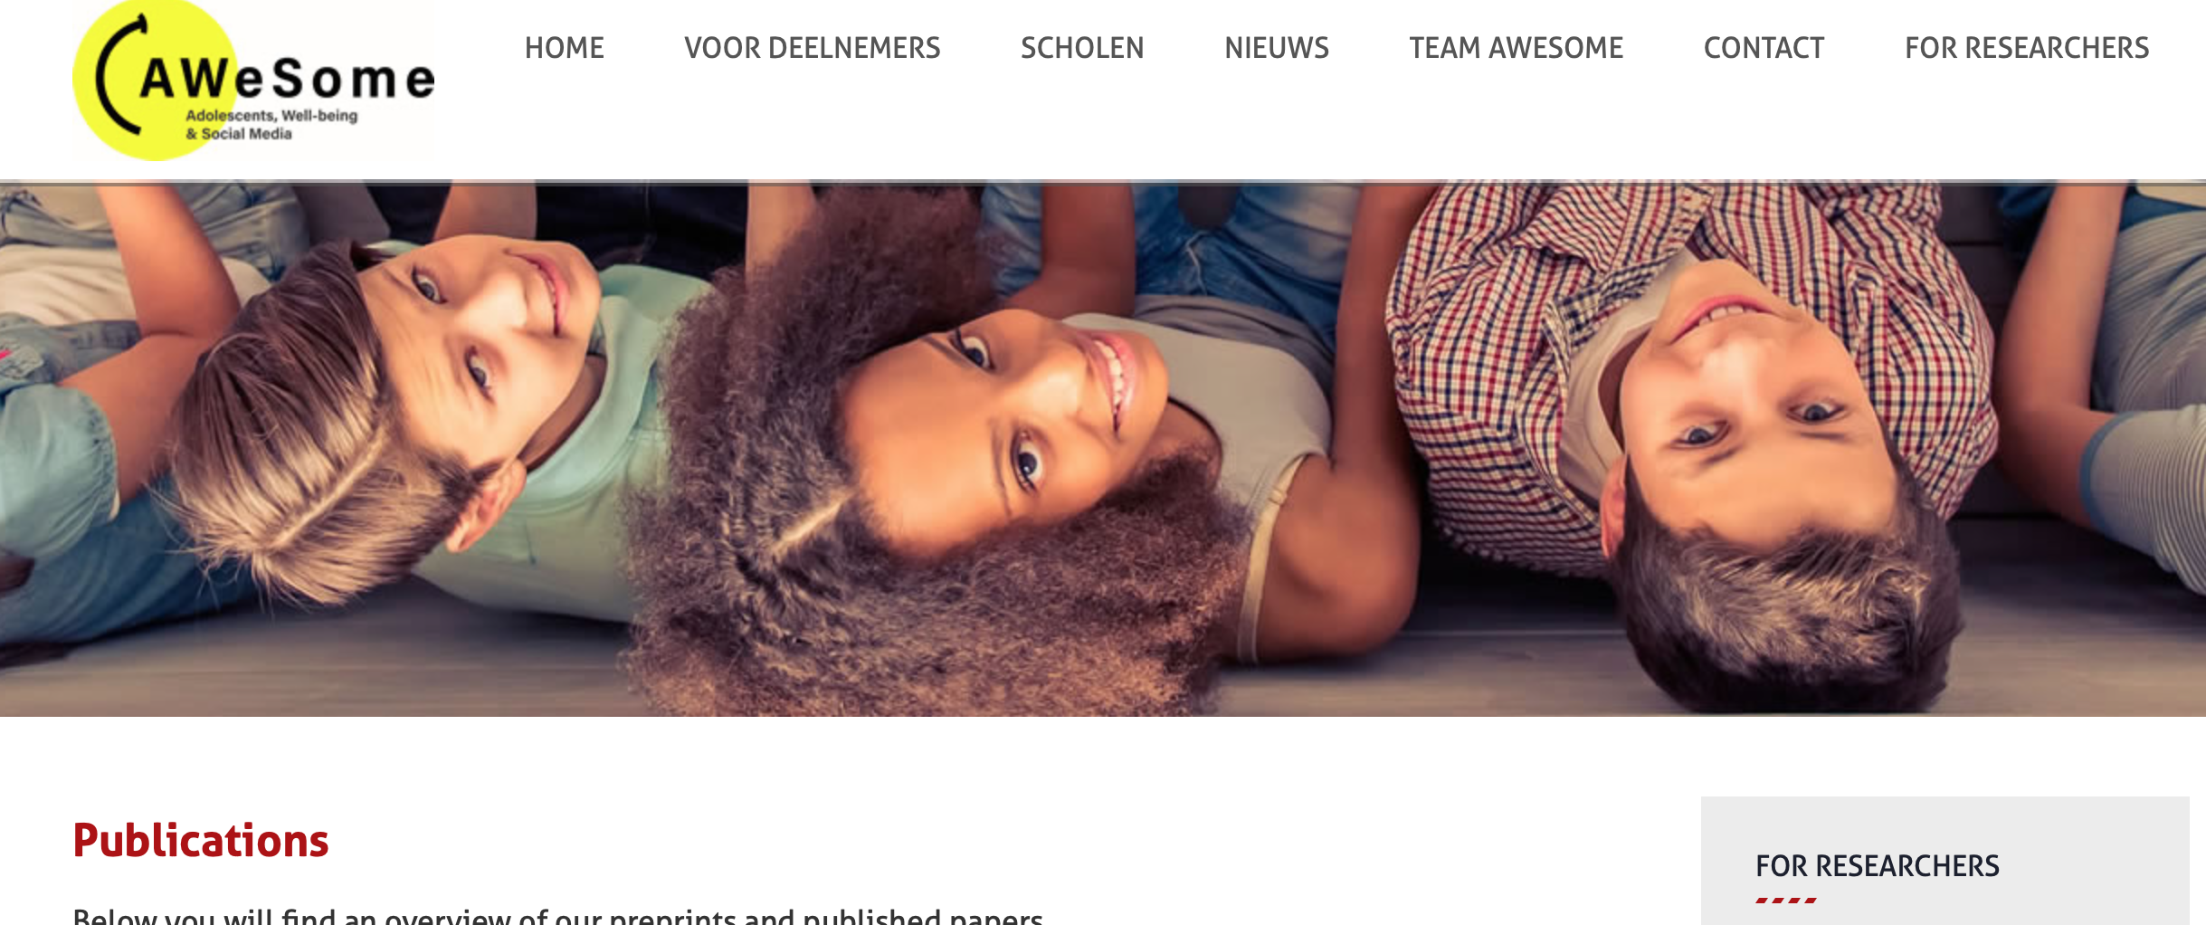
Selectivity in donation of social media data
Project AWeSome (Adolescents, Well-being, and Social Media) by University of Amsterdam
Topics: social media use, well-being, social relationships, self-regulation
Teenagers 13-15 yo in NL, recruited f2f at school, parental consent provided (N = 388)
80% have Instagram account(s)
32% donated Instagram data (raw)

Slide 27
Privacy (again) and loyalty (again) are key
Sociability
Psychological chars
Social media, SP use
Study design
Social comparison
# good friends
Friendship quality
Parental phone rules
Parental knowledge
Adolescent dis- closure & secrecy*** (AME=.10)
Affective well-being
Cognitive well-being
Positive affect
Negative affect
Self-esteem* (AME=-.08)
Loneliness
Self-regulation*** (AME=1.23)
# accounts
Sphone self-monitor.
Sphone type (iPhone)
# followers
Importance followers
# likes on post
Eval. of reactions
Eval. # of reactions
Importance positive reactions
# completed ESM1
# completed ESM2*** (AME=.004)
# completed surveys
Logistic regressions donated (1) vs. did not donate (0), models include sex, grade, education, N varies 146-316.

Slide 28
Giving agency to participants

Slide 29
Privacy-preserving Data Donation Workflow
Boeschoten et al. 2020

Slide 30

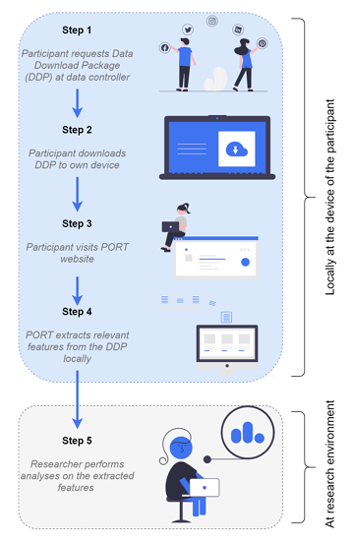
Digital Data Donation Infrastructure (D3I)
With Laura Boeschoten, Daniel Oberski et al.
6 Dutch universities, funding for 3 years
Data donation with local extraction (PORT)
Agency (changing data)
For: Google*, Meta*, Twitter, Netflix, Spotify
Methodological questions:
Understanding of consent
Representativeness
UX
Measurement quality
Validity & Reliability
Boeschoten et al. 2022

Slide 31
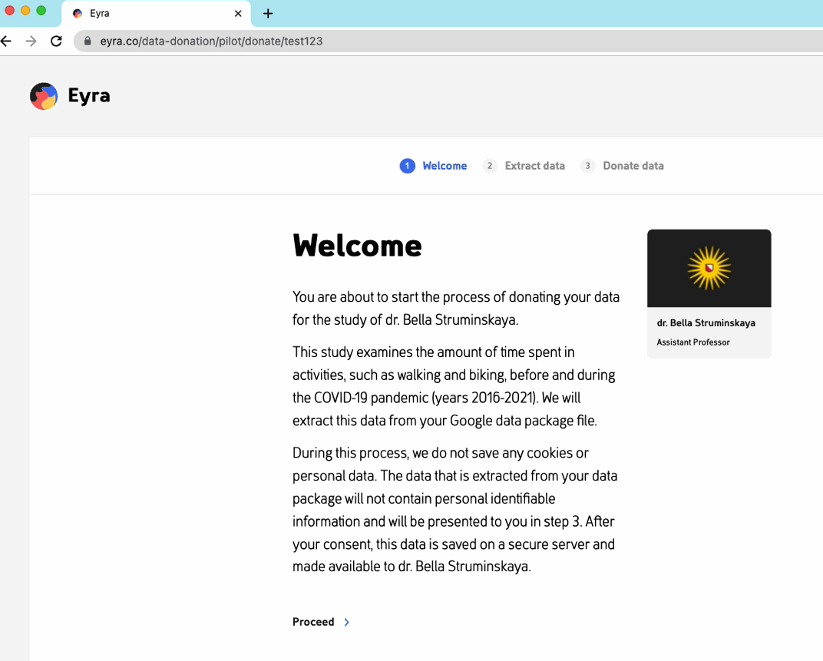
Google Location History Data Donation
Seed project Focus Area Applied Data Science
Together with geographers and computer scientists
Testing the data donation workflow and ERB procedure
Changes to Python script for large-scale implementation

Slide 32
Google Location History Data Donation
Video

Slide 33
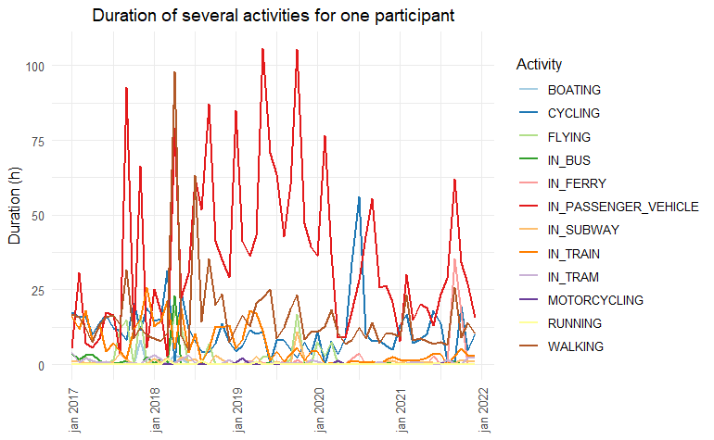
Google Location History Data Donation

Slide 34

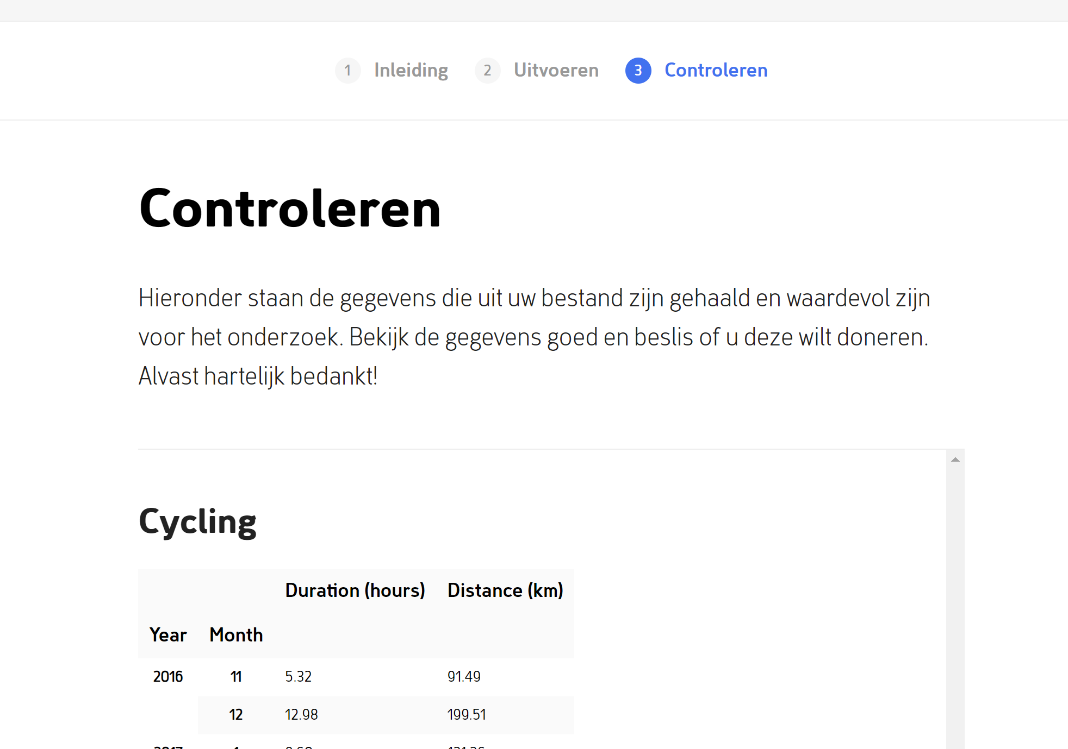
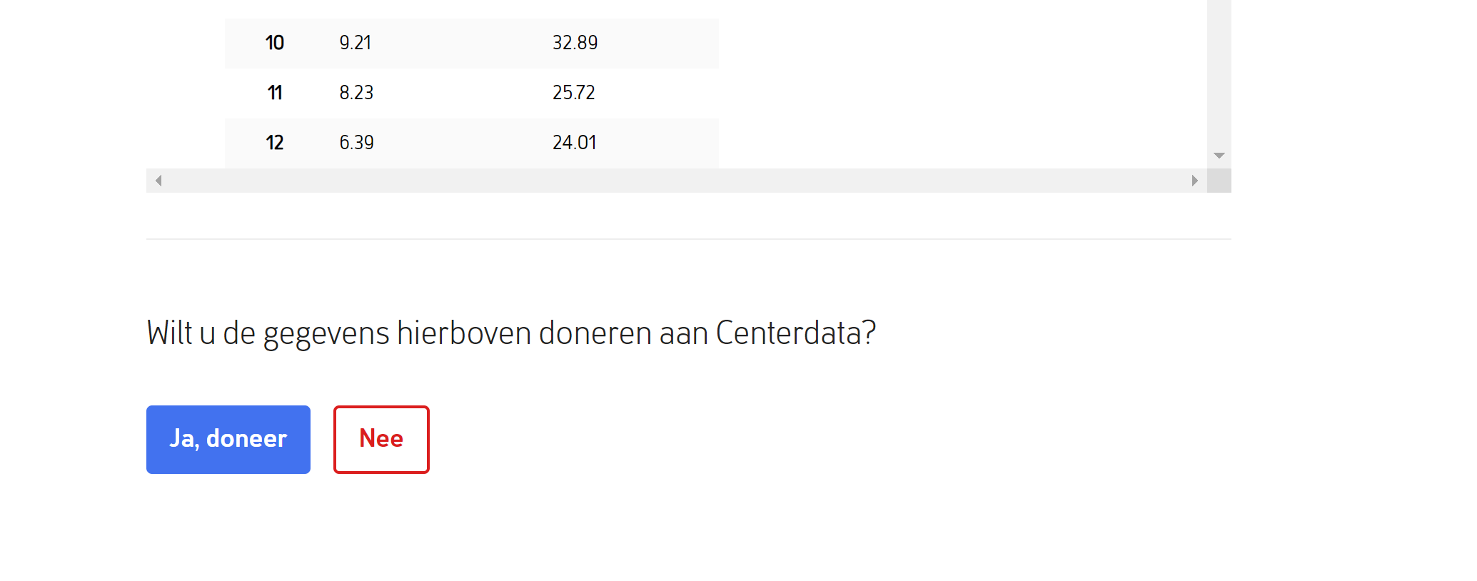
Google Location History Data Donation
Study in CentERpanel August 2022
N=1035 (75% AAPOR RR1)
Integration of data donation (PORT)
Willing = 30%, 144 donated (14%)
Methodological questions:
Visualization prior to request
Understanding of consent request
Incentive amount (5€ vs. 10€)
Nonparticipation bias

Slide 35
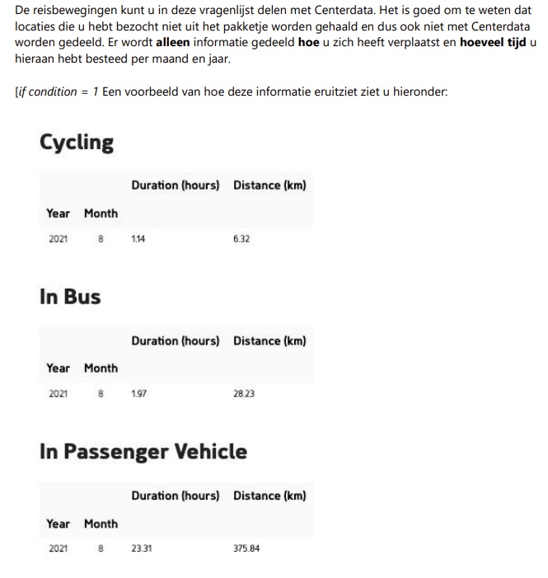
Incentive & visualization
No difference in incentives
5€: willing to donate 32% (n=147)
10€: willing to donate 34% (n=159)
Chi2(1) = 0.32, p=.574
Donated: 48% vs. 46% (Chi2(1) = 0.17, p=.676)
No difference by showing how data looks like
Visualized: willing to donate 34% (n=159)
Not visualized: willing to donate 32% (n=147)
Chi2(1) = 0.56, p=.456
Donated: 46% vs. 48% (Chi2(1) = 0.17, p=.676)

Slide 36
Understanding the consent request
Statements asked to respondents | Correct % | Incorrect % | Don’t know %
You are asked to download information from Google. TRUE | 48.8 | 19.8 | 31.4
The software implemented in the survey will extract the information on the number of hours you cycle, walk, take public transport, travel by car. TRUE | 62.3 | 6.1 | 31.2
Information on all the locations you visited will be shared with Centerdata. FALSE | 39.2 | 31.4 | 29.4
Google collects information on location about everyone. FALSE | 24.8 | 46.6 | 28.5
From the data you will provide, the information can be traced back to you. FALSE | 45.3 | 22.2 | 32.5
You will be able to inspect the data before sending it to Centerdata. TRUE | 59.0 | 7.8 | 33.1
It is impossible to identify you as an individual from the data that you provide. TRUE | 43.4 | 19.6 | 37.0

Slide 37
Understanding the consent request
5.5% had everything correct
Mean correct: 3.23, median = 4
People with more correct answers more likely to be willing & to donate:
4.54 correct statements for willing
2.56 correct statements for non-willing
OR = 1.572, p <.001
5.33 correct statements for donated
3.94 correct statements for not donated
OR = 1.795, p <.001

Slide 38
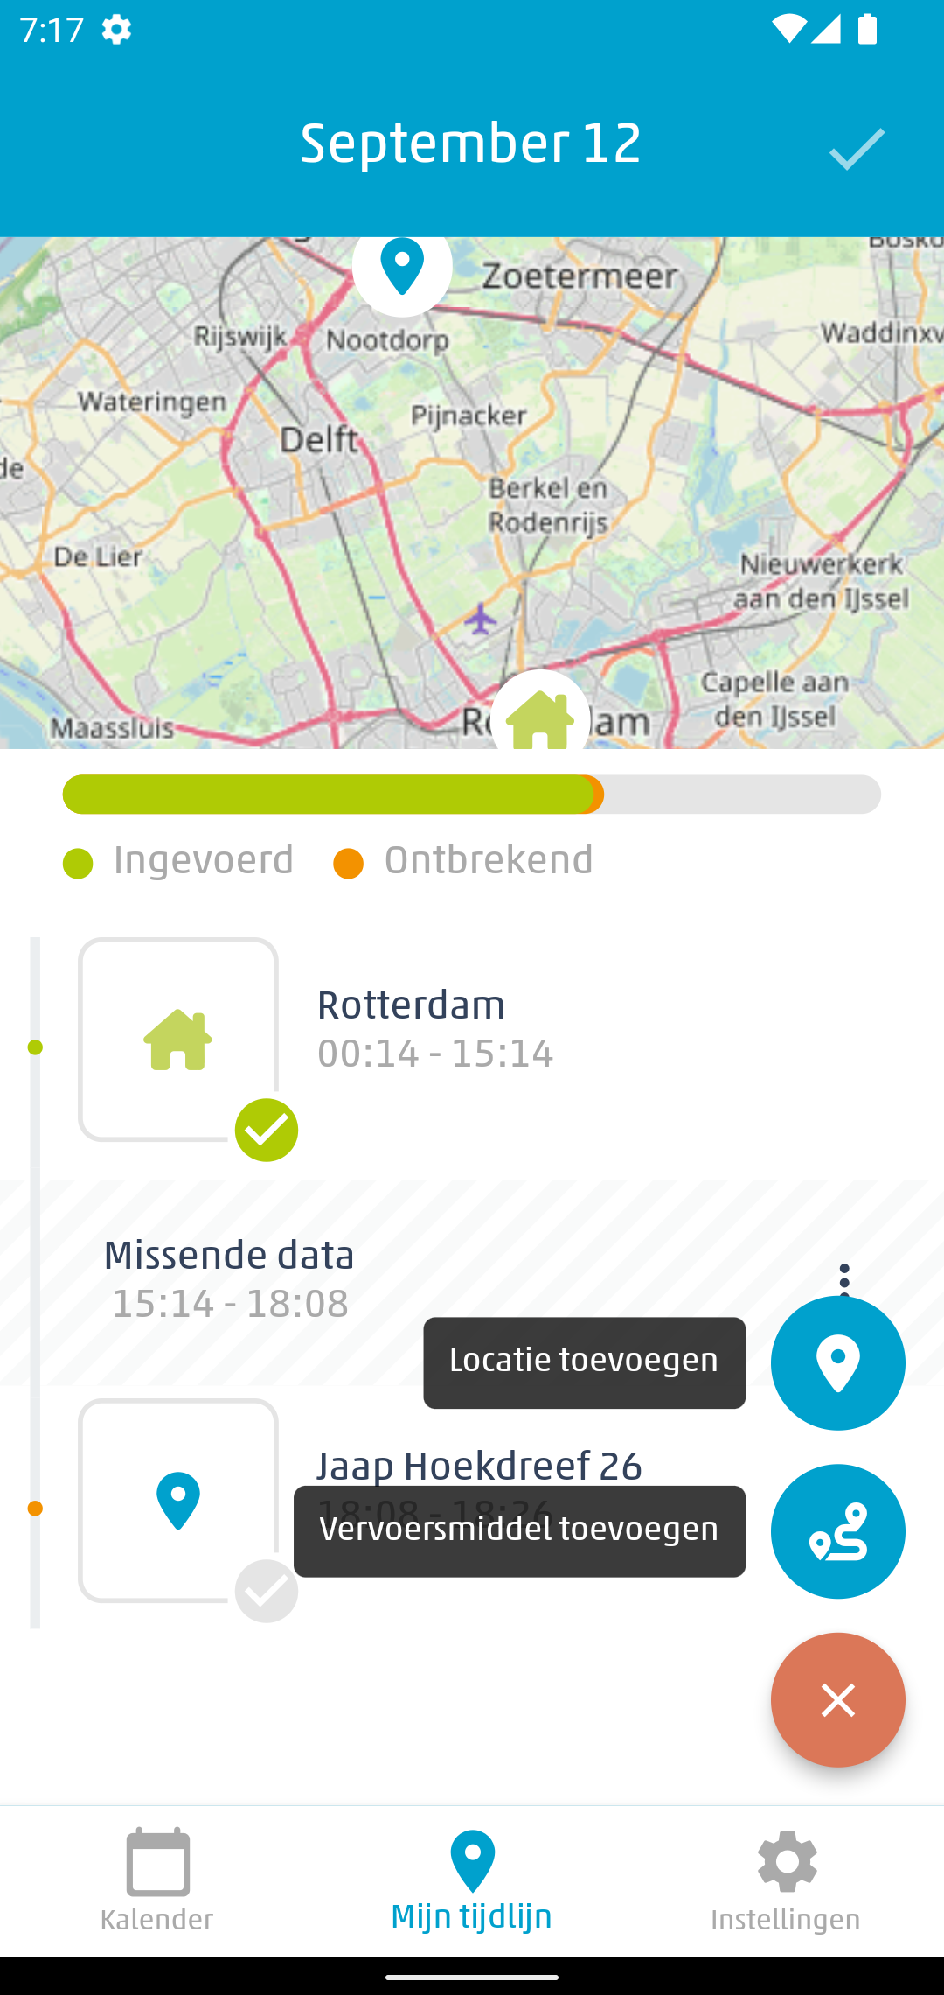
Respondents’ agency in app-based surveys
Household Budget Survey (HBS) fall 2021,
NL, ES, LU
N=3916, Completion = 16%
No influence of feedback on representativeness, data quality
Travel app possibility to provide context to passive data, add data
Rodenburg, Schouten, Struminskaya

Slide 39

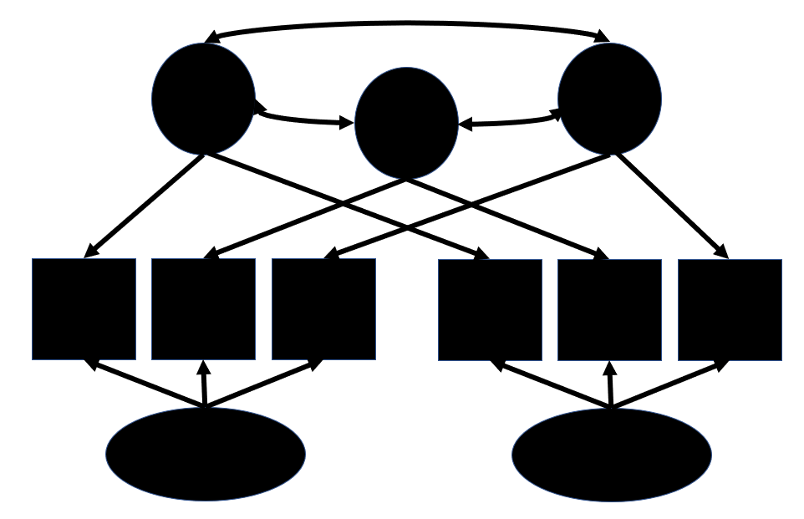

Research agenda
Participant agency, informed consent, legal guidelines for data donation
D3I pilots with various data sources (w/Araujo, Boeschoten, et al.)
DBD measurement quality, reliability & validity
Algorithmic bias (w/Ruben Bach, U Mannheim)
Interventions based on digital trace data
Book under contract CRC Press (w/Keusch, Eckman, Guyer)
Trusted Smart Surveys
Increasing representation & adherence, UX and app design (w/Danielle, Peter, Barry, Eurostat)
Data donation in official statistics (w/Laura, Thijs, Danielle, Barry, CBS)
Feedback effects (w/Evelien Rodenburg, Barry Schouten, Danielle Remmerswaal)
Data Integration
Integration of prob & nonprob surveys & sensors (w/Camilla Salvatore et al.)
Integration of DBD and surveys (w/CBS)
Extending traditional data collection infrastructures
Secure data linkage, informed consent to novel data types (w/Emery et al.)

Slide 40
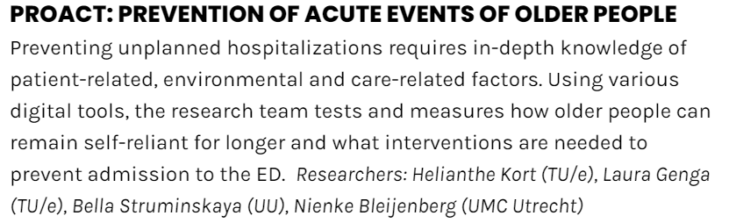

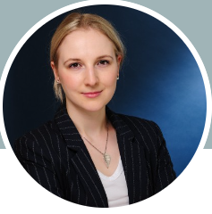
Some final bits
Most recent
Seed funding Institute 4 preventive health
Will appreciate brainstorm!
Some other ongoing
DFG-sponsored project “Panel conditioning in longitudinal studies”, UU external PhD candidate Fabienne Krämer, visiting M&S March-April 2023
More traditional survey methods: PhD students Isabella Minderop, Alexandra Asimov, Hannah Schwarz

Slide 41


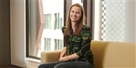
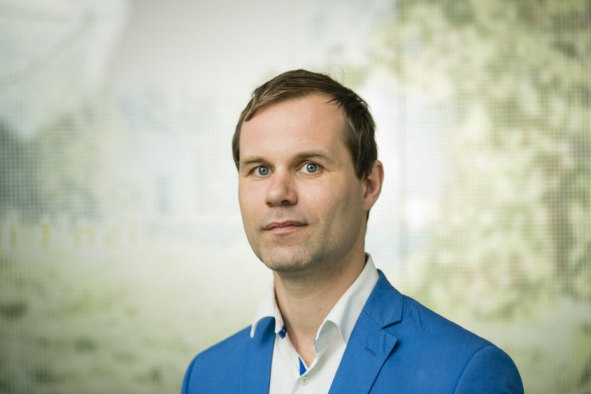


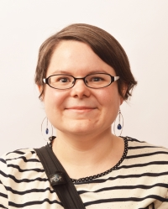
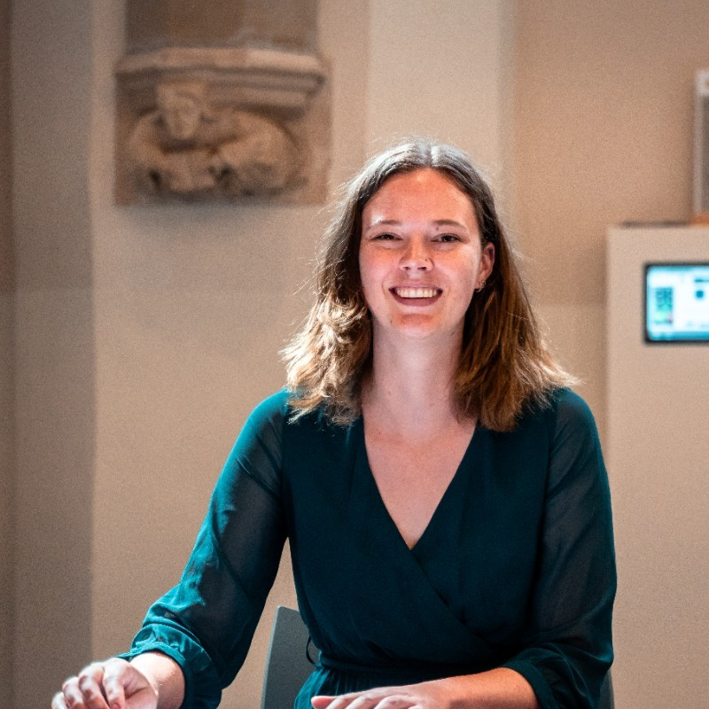


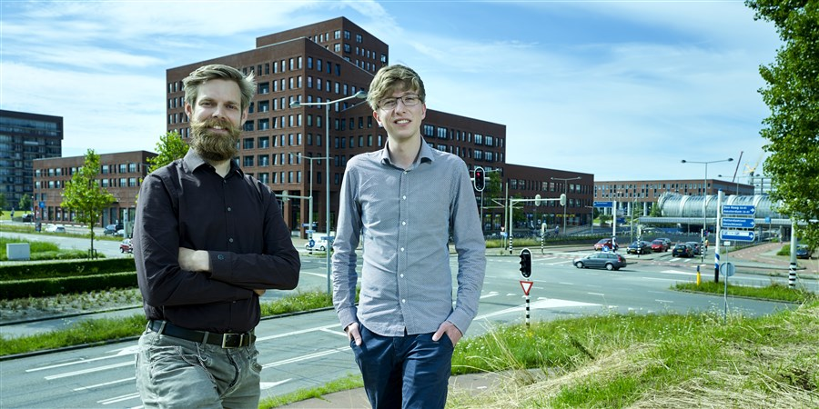



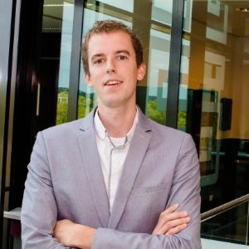
Acknowledgements
Peter Lugtig, Barry Schouten, Danielle McCool, Katie Roth, Laurent Smeets, Ole Mussman, Jelmer de Groot, Vera Toepoel, Deirdre Giesen, Tom Oerlemans, Ralph Dolmans,Annemieke Luiten, Vivian Meertens, Jesper van Thor, Jeldrik Bakker, Evelien Rodenburg, Anne Elevelt, Tom Oerlemans, Laura Boeschoten, Thijs Carriere, Niek de Schipper, Daniel Oberski, Danielle Remmerswaal, Florian Keusch, Christopher Antoun, Mick Couper, Frauke Kreuter, and more

Slide 42
Thank you!
Contact:
b.struminskaya@uu.nl
https://bellastrum.com
@bellastrum

Slide 43
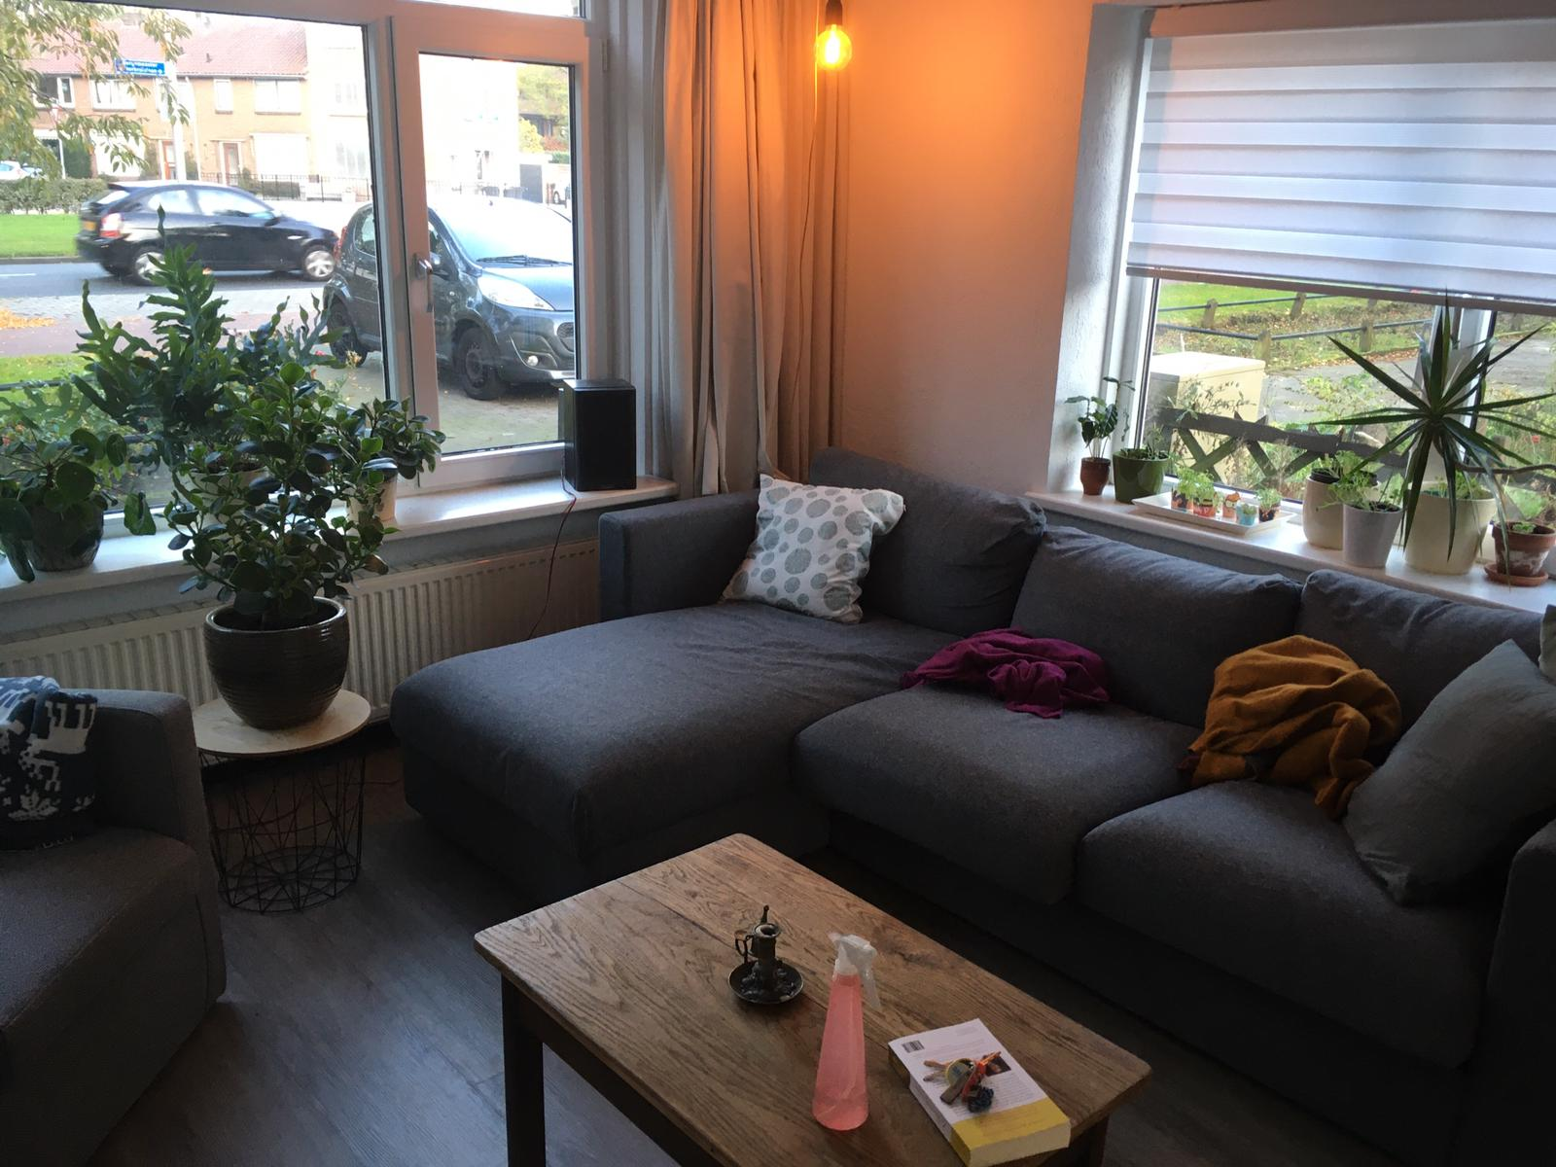
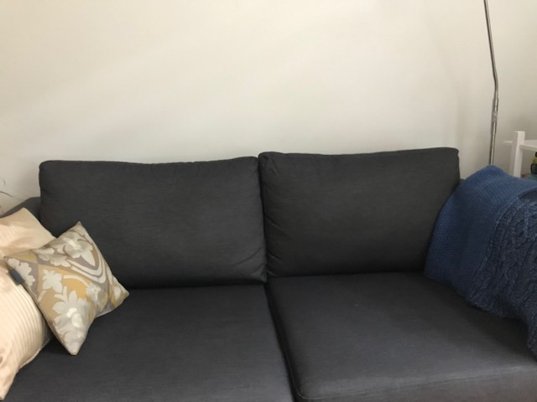
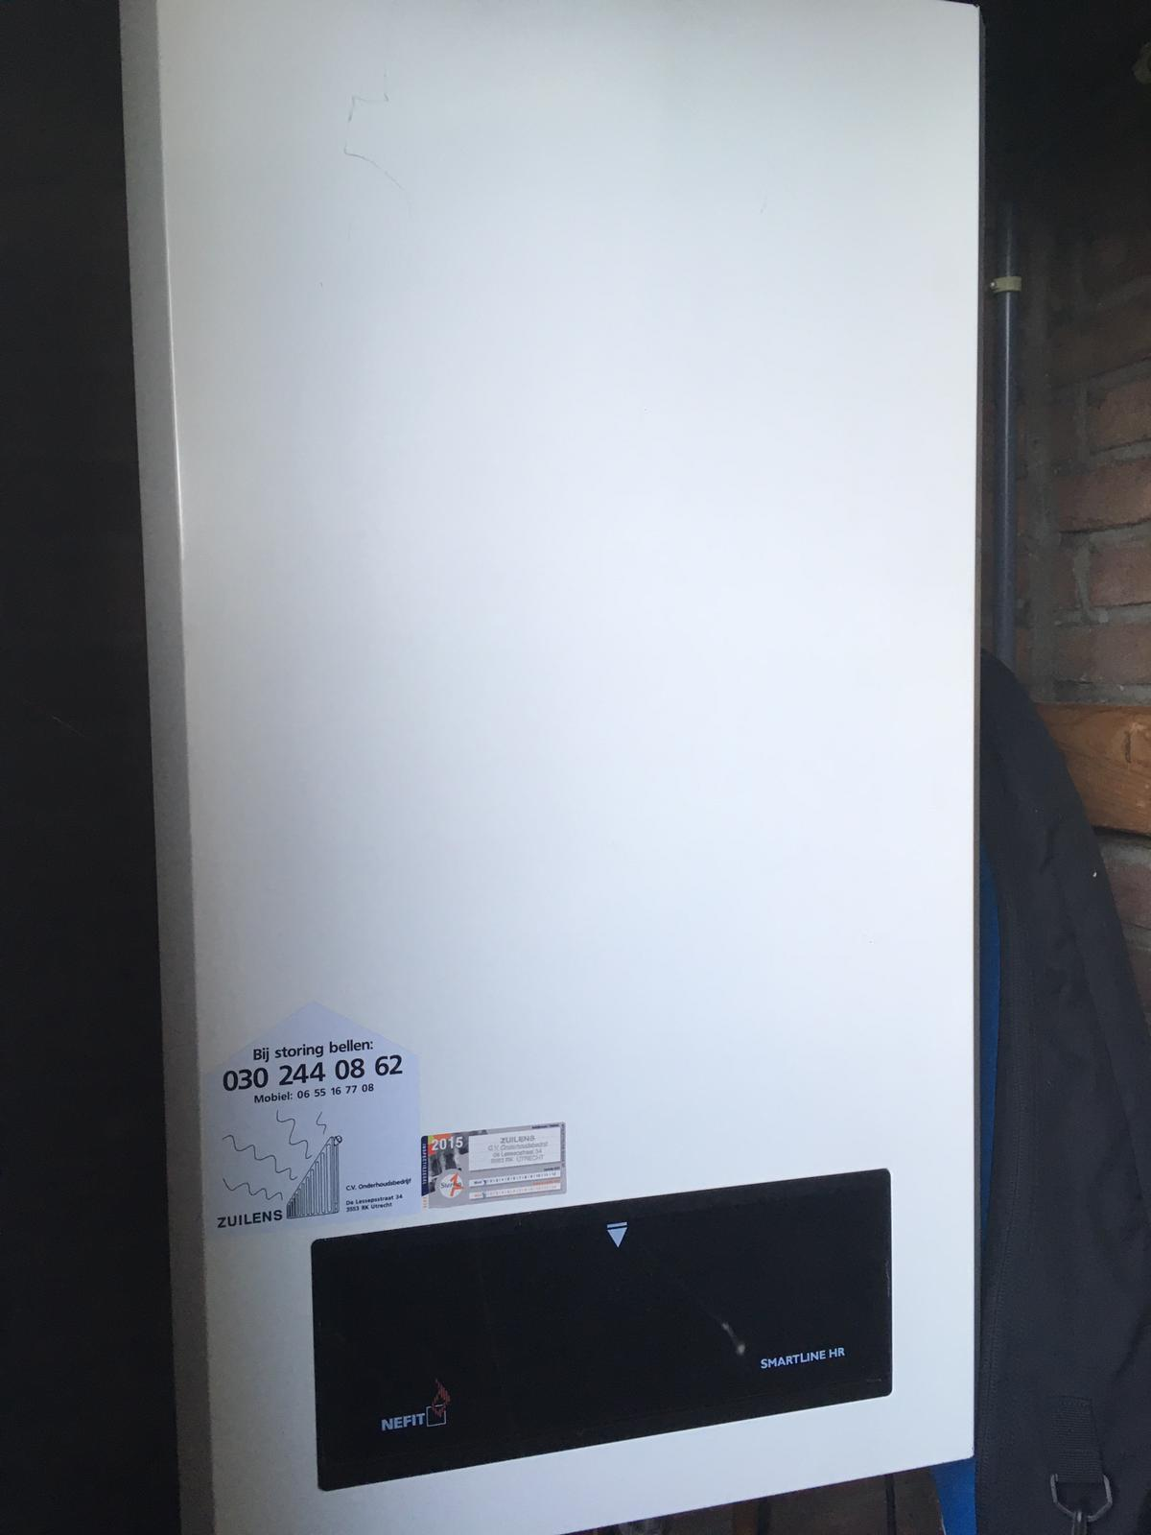
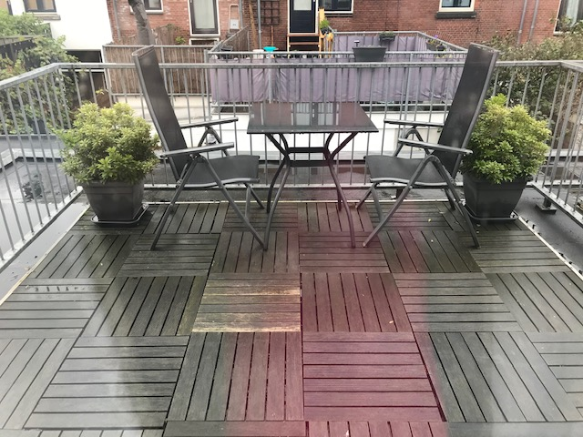
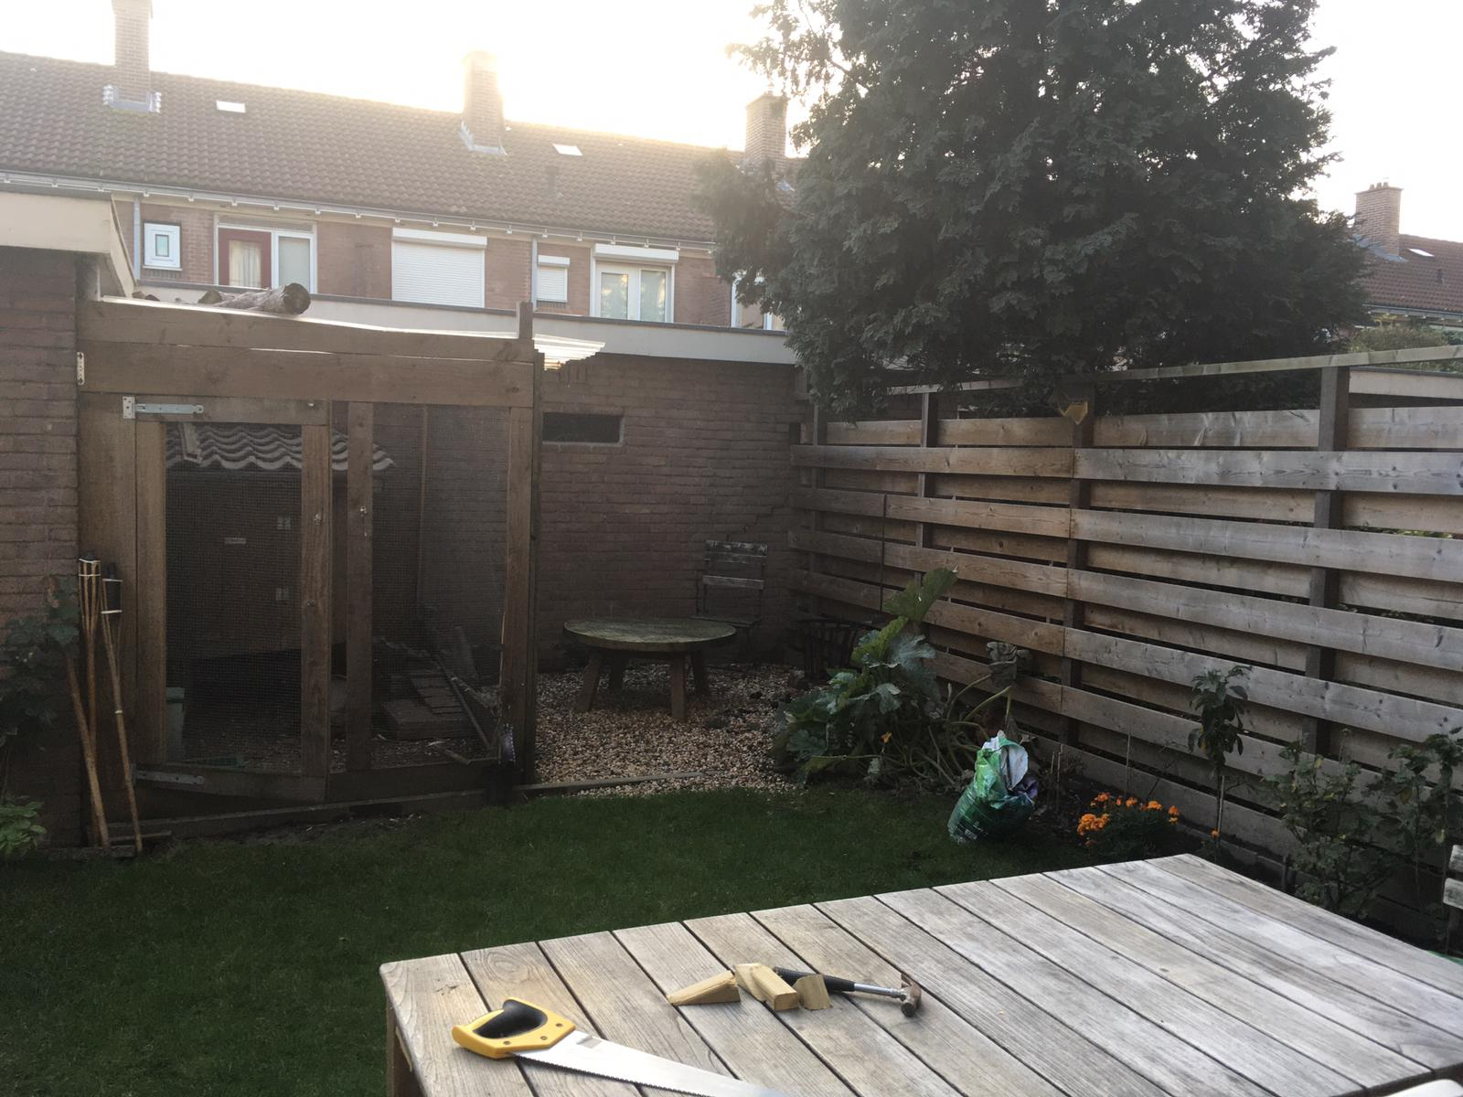
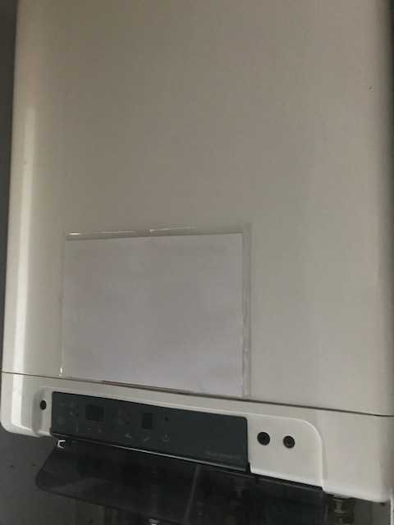
Sensor measurements in context: What are people’s living conditions?
Note: pictures recreated, not actual pictures submitted by respondents
Photo of favorite place in their dwelling
Photo of garden/balcony/patio/terrace/courtyard
Photo of a heating element
43% / 29% / 36% photos vs. 99%/67% text
Information on heating device manually extracted (n=321 pictures)
88% made pictures in line with task
In 44% model & specifications extracted with OCR: comparable to self-report

Slide 44
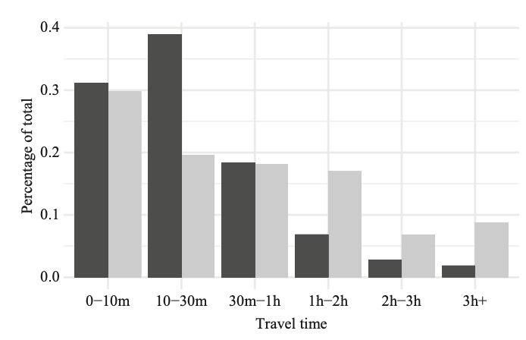
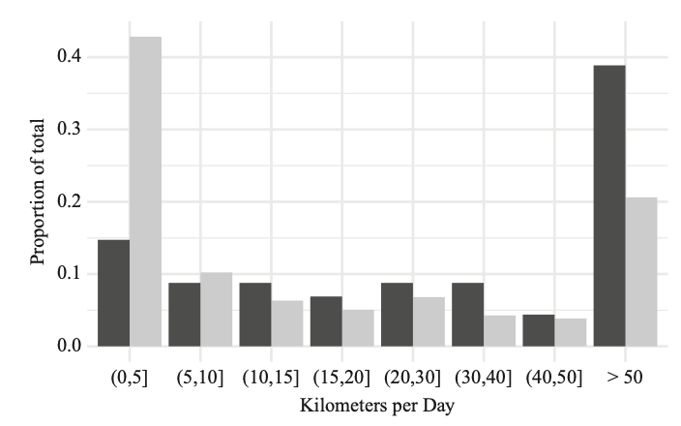
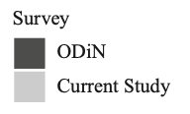
App data compared to web diary self-report (ODiN)
McCool et al. (2021)
Notes:
Florian

Slide 45
Linked the two data sources and created heat maps to understand the relationship between air pollution and health outcomes. Exposure to pollutants together with having lived in the neighborhood for a longer period of time is significantly related to respiratory health issues.
DOI: 10.1177/0894439320920601

Slide 46
Equiped >600 students with fitbits to study development of social ties over time. Dyads that tend to adopt similar temporal trajectories in terms of physical activity are more likely to be similar in ethnoracial staus and religious affiliation and more likely to end up connected in the communication network. Emergence of social ties seems to be impacted by synchronization in dynamic behavioral space among individuals.
Being in the same behavioral trajectory cluster is less useful for predicting whether a given dyad is composed of individuals with the same or different gender: similarity in physical activity trajectories is less tied to this marker than it is to race and religion
DOI: 10.1177/0894439320923123

Slide 47
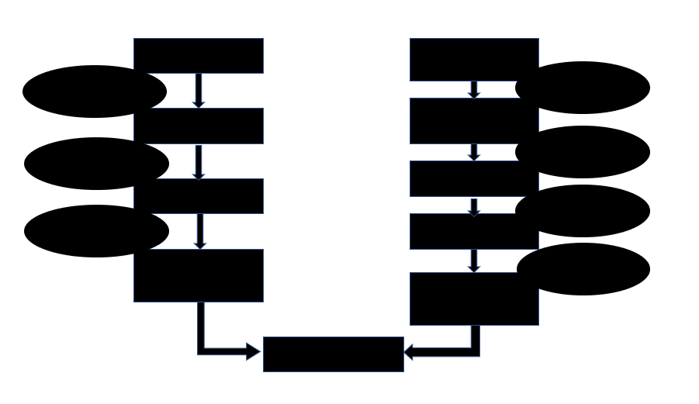
Research agenda
Participant agency, informed consent, legal guidelines for data donation
D3I pilots with various data sources (w/Araujo, Boeschoten, et al.)
Measurement quality, reliability & validity of DBD
Algorithmic bias/profiling across platforms (w/Araujo, Boeschoten, et al. UvA) (w/Bach, U Mannheim)
Interventions based on digital trace data (w/Van Woudenberg, et al. U Rotterdam)
Book CRC Press (w/Keusch, Eckman, Guyer)
Increasing representation & adherence via UX and app design
Trusted Smart Surveys: Travel, Budget, Indoor climate, Working conditions (w/CBS)
Data donation in official statistics: energy use, receipts (w/Remmerswaal, Schouten, other CBS’ers)
Feedback effects (w/Rodenburg, Schouten, Remmerswaal)
Data quality assessment with Machine Learning (w/Lugtig)
Extending traditional data collection infrastructures
Secure data linkage, informed consent to novel data types (w/Emery et al.)
Traditional survey methodology to inform digital data research
Integration of probability & nonprobability sources (w/Salvatore, Biffignandi, Sakshaug, Wisniowski)
Nonresponse rates vs. nonresponse bias update (w/Lugtig, Groves, Peytcheva)
Panel Conditioning & Reactivity (w/Krämer, Silber, Bosnjak, Weiß)(w/Cernat, Sakshaug)

